Slide 1


COS 301
Demonstration One

Slide 2

Table of Contents
Challenges
Use Cases
Screenshots
Platforms
UML Class Diagram
Unit Tests
System Requirements
Functional Requirements
System Overview
The Mock Up
Team Members
Architectural Requirements
Methodology
Completed Sections
Other Documentation
Scrum
Meeting Times
Architecture
Server Standards

Slide 3
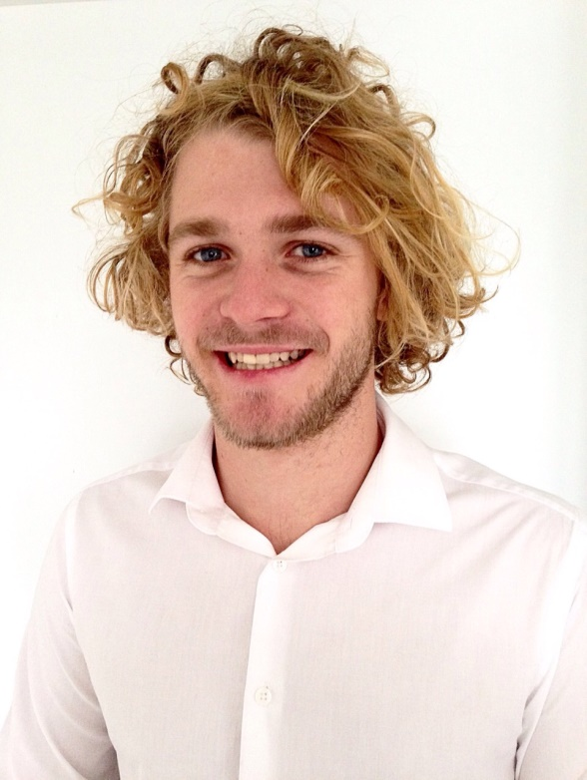
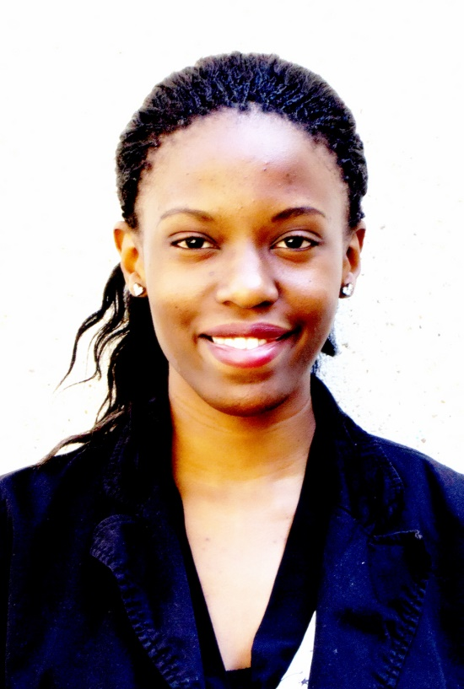
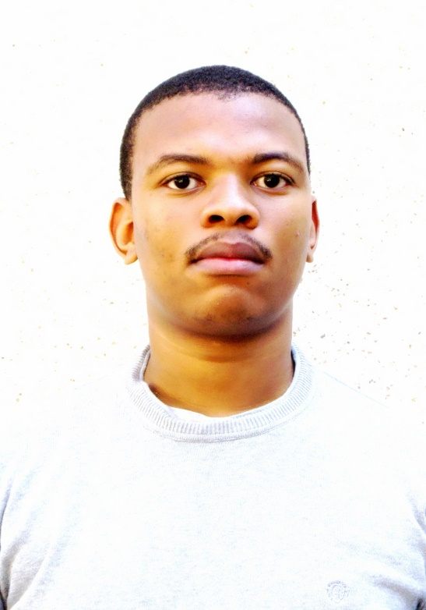
The Team
Trevor Austin
Liz Joseph
Lindelo Mapumulo
Software Engineer
Software Engineer
Software Engineer
Team lead that provides the team with motivation and direction
Team coordinator that keeps the team organised and professional
Team resource investigator that provides the team with modern and valuable information
Notes:
Trevor –Team Lead
Liz –Team Cood
Lindelo – Team Software

Slide 4
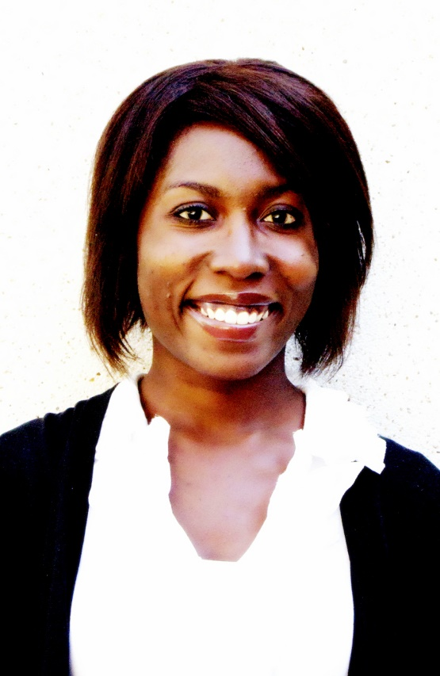
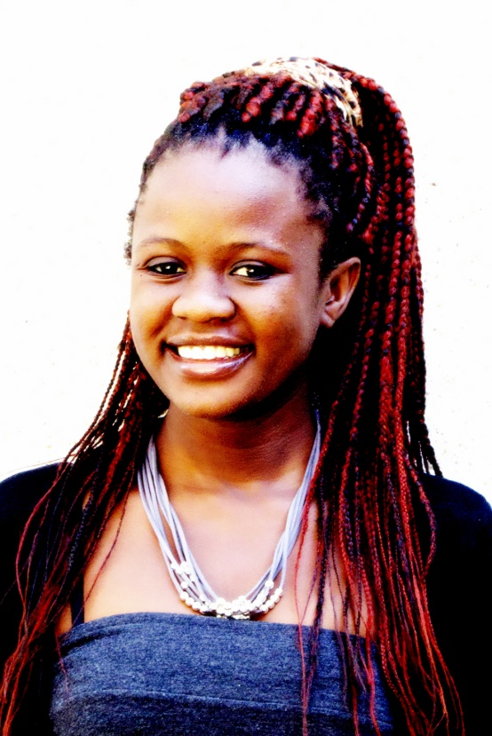
The Team
Ruth Ojo
Maria Qumayo
Developer
Developer
Team planner that keeps the team on the objective track
Team shaper that provides the team with structure and direction
Notes:
Ruth – Team Planner
Maria – Team shaper

Slide 5
System Requirements
A system that implements a login hierarchy
Allows users to enter forms at their specific hierarchical level
Implement a normalized database of a large system
Provide administrators access to records and statistics
Provide security and encryption of sensitive data
Notes:
End with you may ask yourself, what are these students doing? I can answer that for you

Slide 6

Patient Information Management System
Our current project is to implement a working database management system that provides statistics and information. Users will also be able to input multiple forms of data. The purpose of this system is to streamline to data input to the system. The current problems with the system is the rate of data capturing is not rapid enough to keep up with the intake of patients & data. Our job is to streamline this process as well as providing security and ultra-modern minimalistic usability. The system will provide fast response times and an optimized database system.
Notes:
-Working database management system
-Stats & info
-Input forms
-Streamline input
-Current problems: rate of data capture vs. patints
-We must streamline
-Security & ultra-modern minimalistic
-Fast response times
-Optimized database system

Slide 7



Platforms
mobıle
desktop
portable

Slide 8
Possible Challenges
Database design:
Complex
Large
Generic
Generic Programming
Polymorphic Code
Dependency Injection

Slide 9
Methodology

Slide 10
Scrum: Agile Software Development
Creates a team atmosphere
Product backlogging
Sprint Planning
Sprint Reviews
Burn out charts
Scrum board
Notes:
-Product backloging = prioritization
-Sprint planning = 15 mins
-Sprint Review = 15 mins
-Burn out charts = sum of work done
-Scrum board = work allocated

Slide 11
Burnt out charts

Slide 12
Meeting Times
Group Meetings
Wednesday: 15:00
Friday : 12:30
Client Meetings
Completion of programming module
Problems with System
Recent Project Demonstrations

Slide 13





Communication Standards
Whatsapp
Google Calendar
Google Hangouts
Gmail
Group Meetings

Slide 14
GIT Standards
Two Repositories
Documentation branch
Prototype
Unedited
Master
Source-Code branch
Master(Stable)
Experimental
Bug-fixing

Slide 15
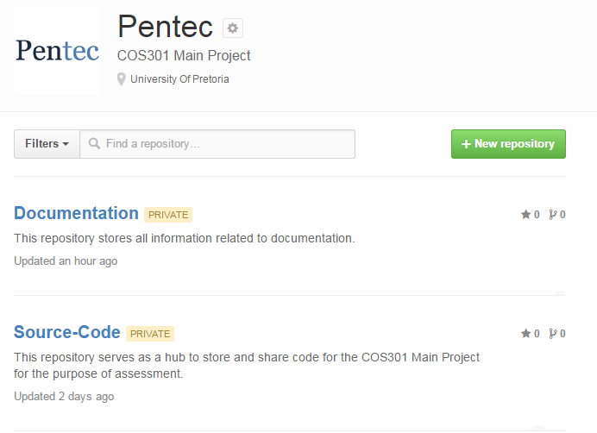
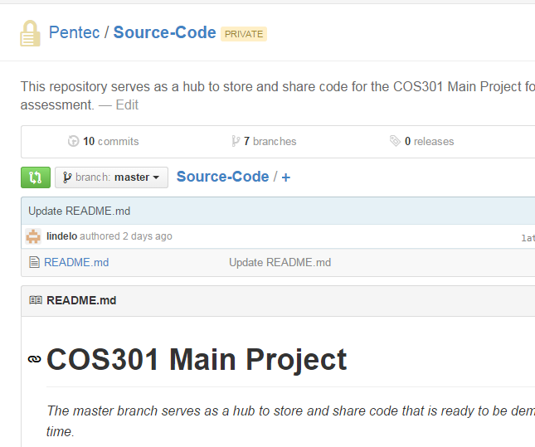
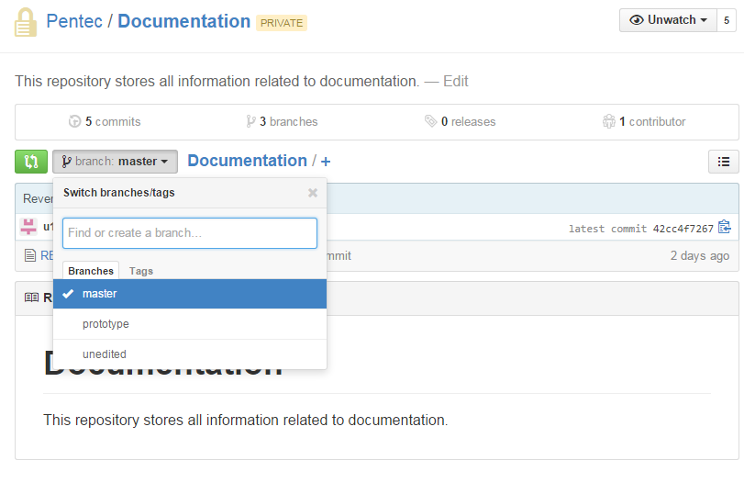
GIT Repositories

Slide 16
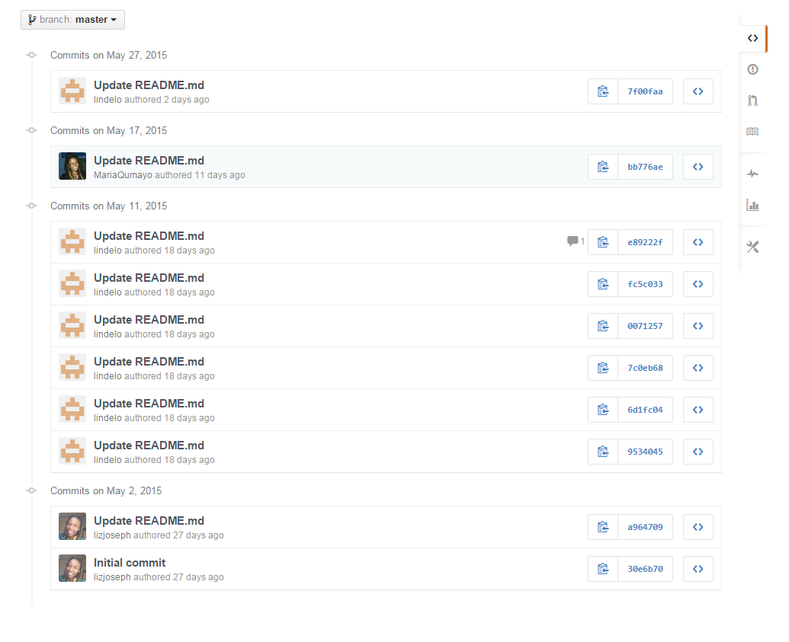
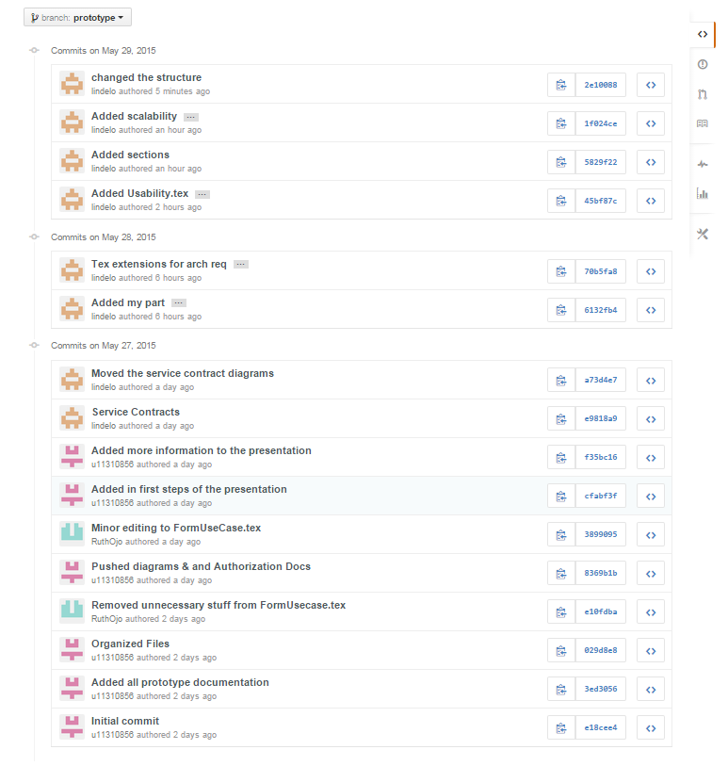
GIT Activity

Slide 17
Functional Requirements

Slide 18
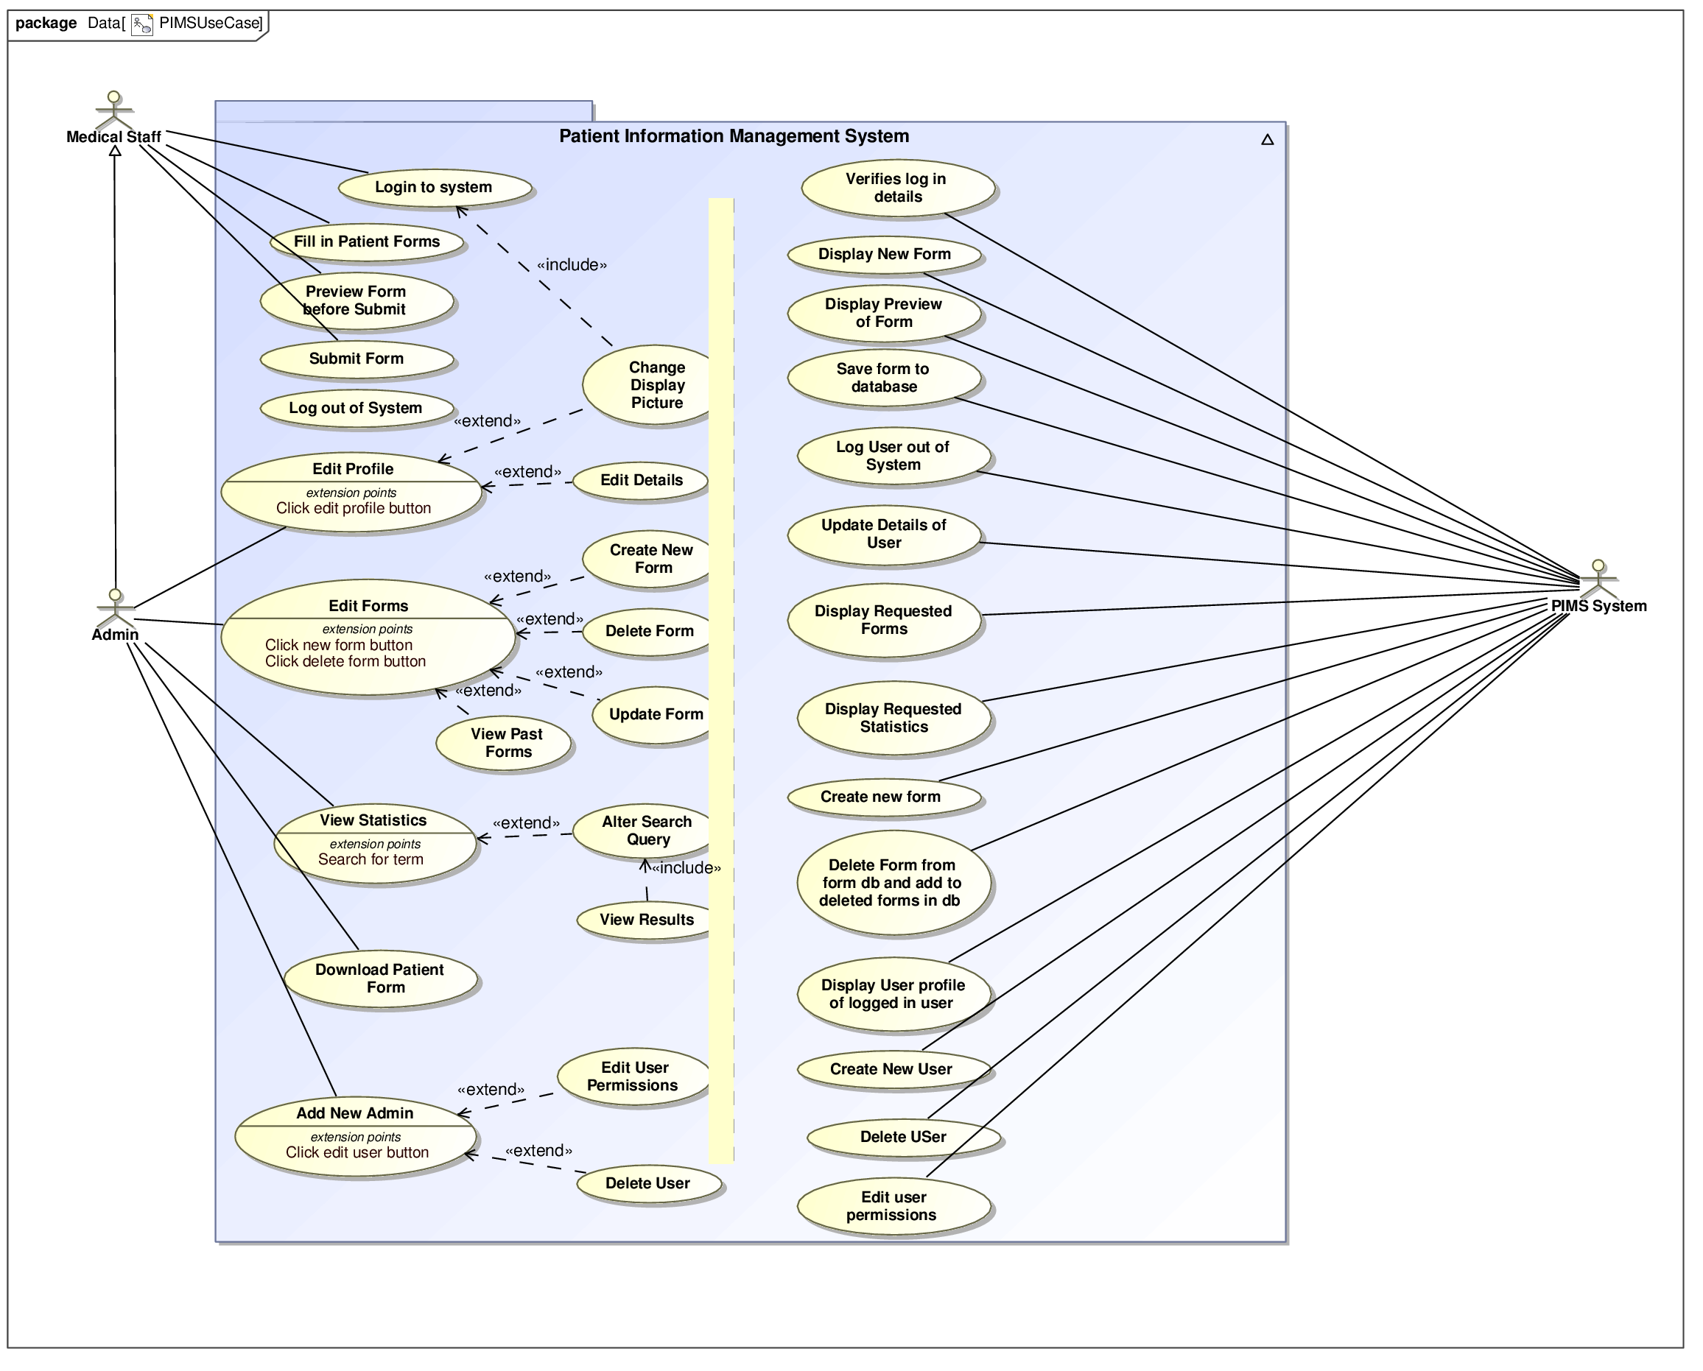
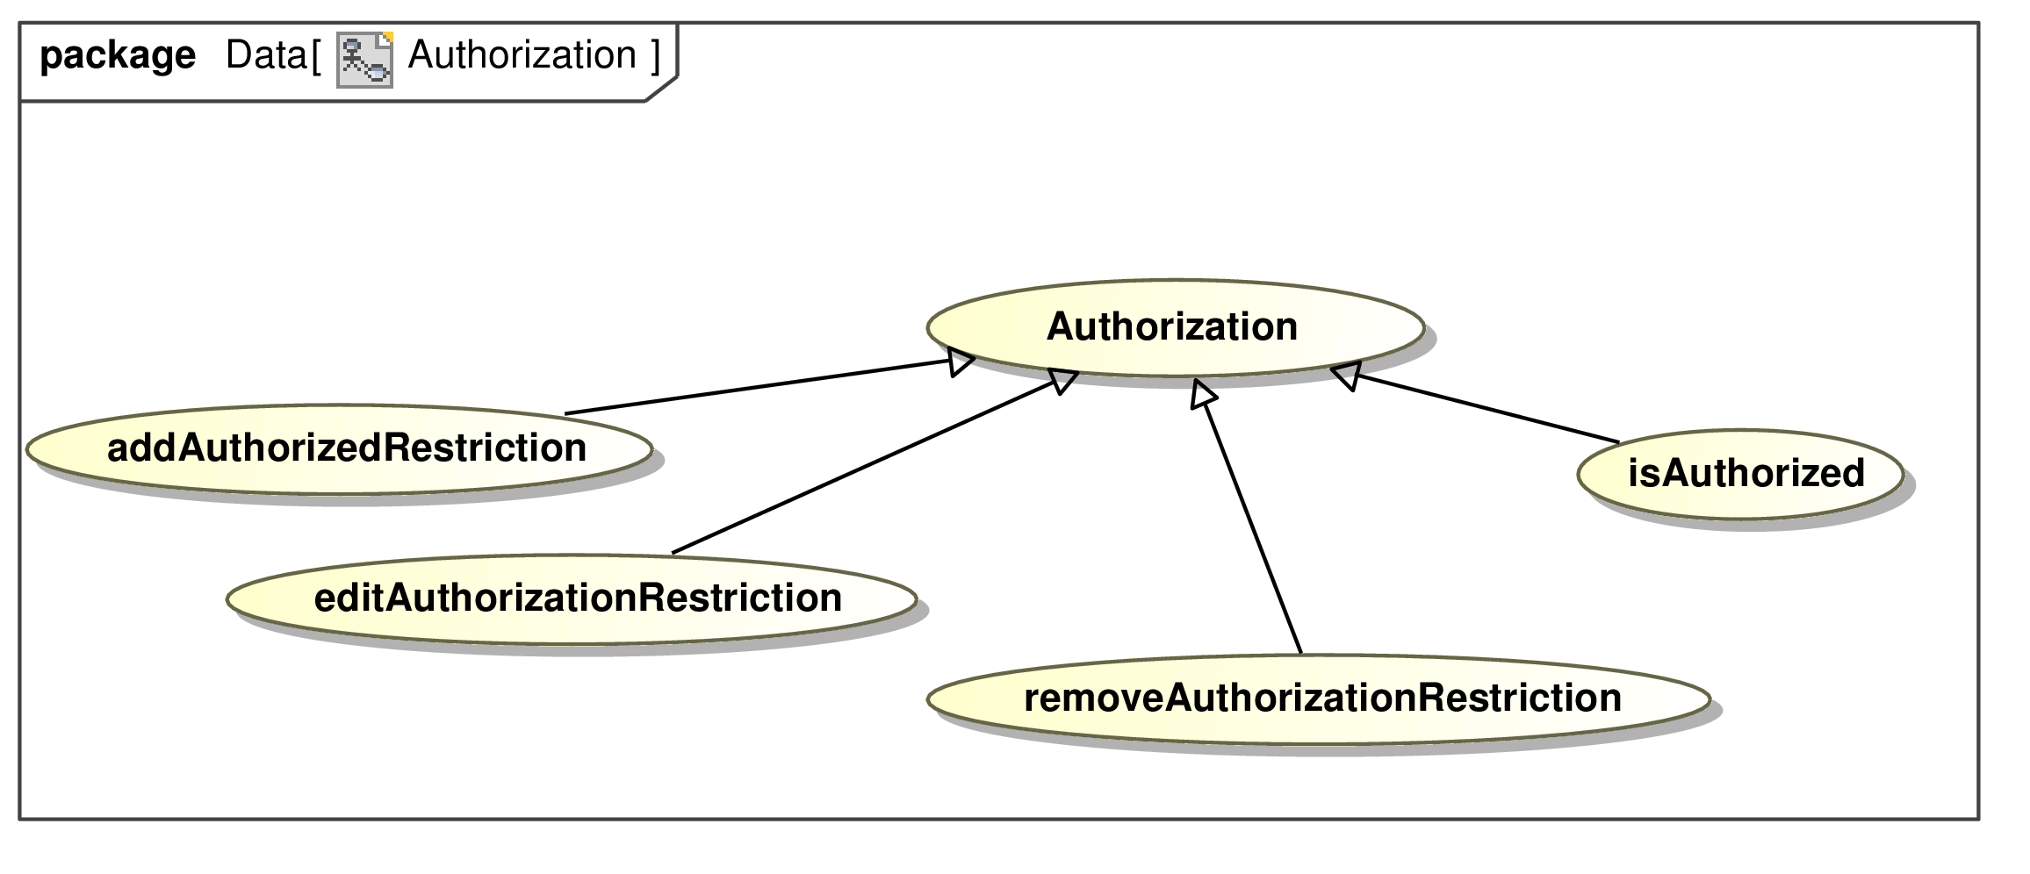
Use Cases

Slide 19
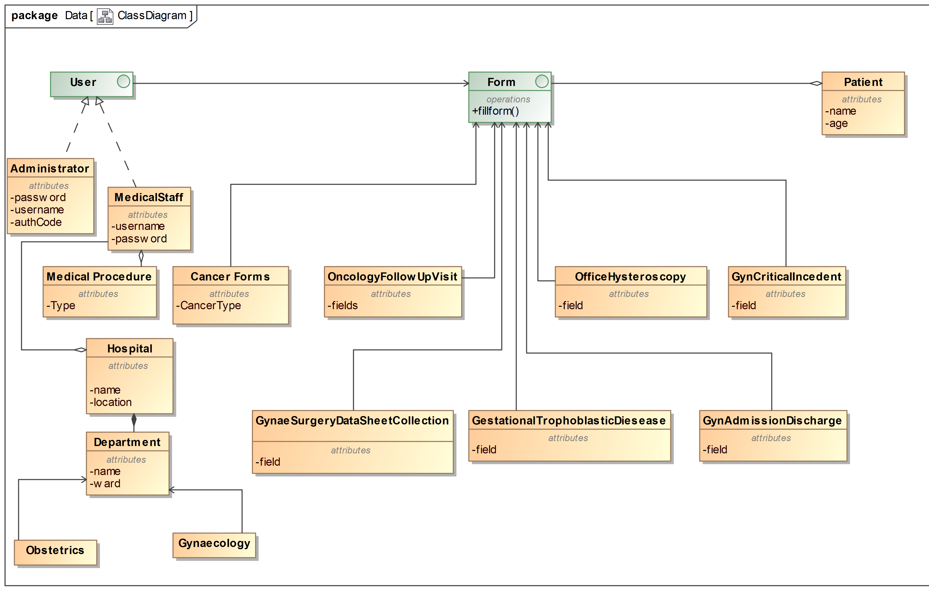
UML Class Diagram

Slide 20
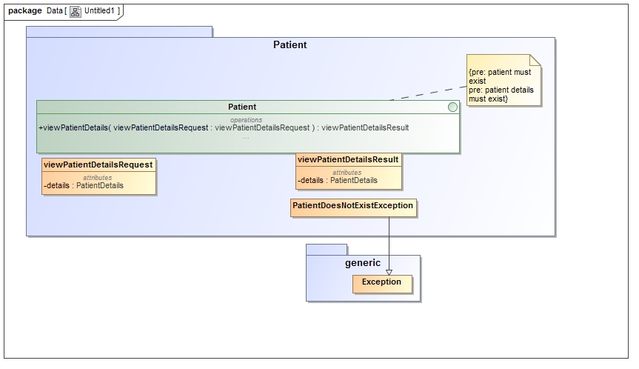
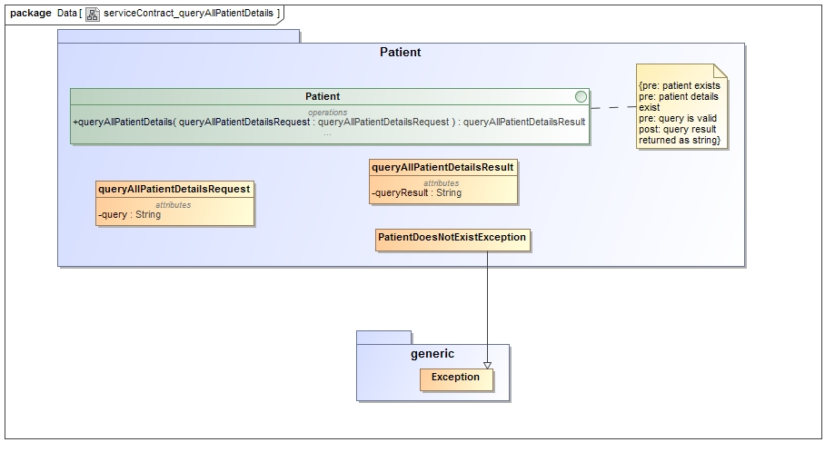
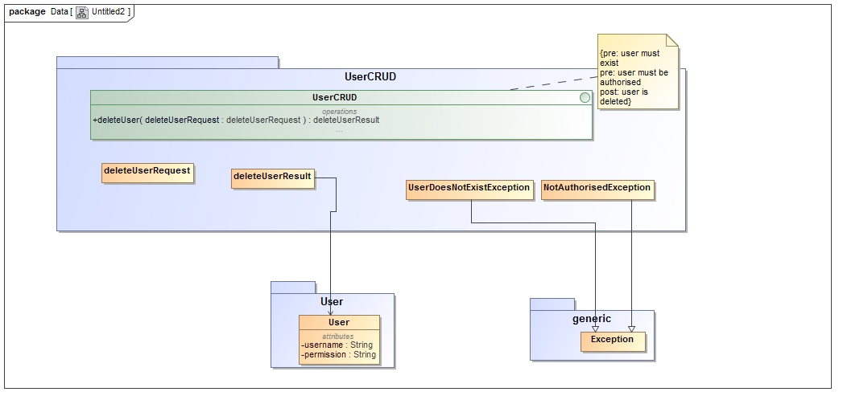
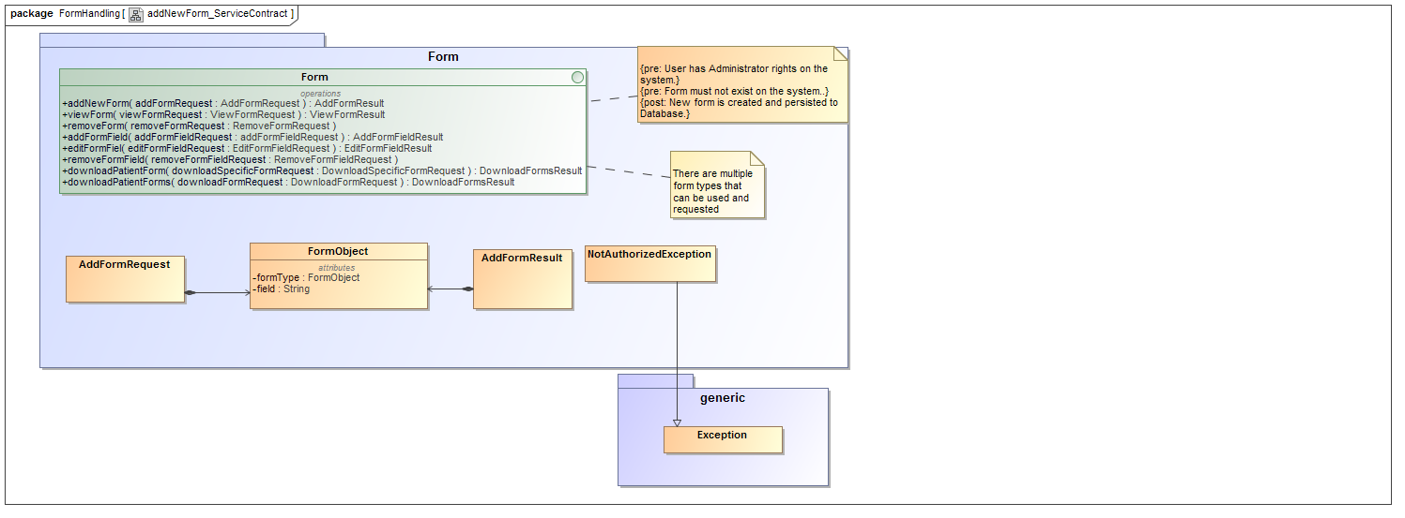
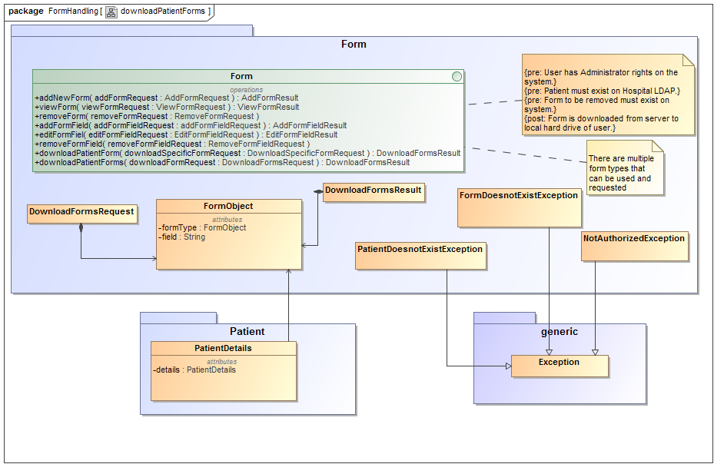
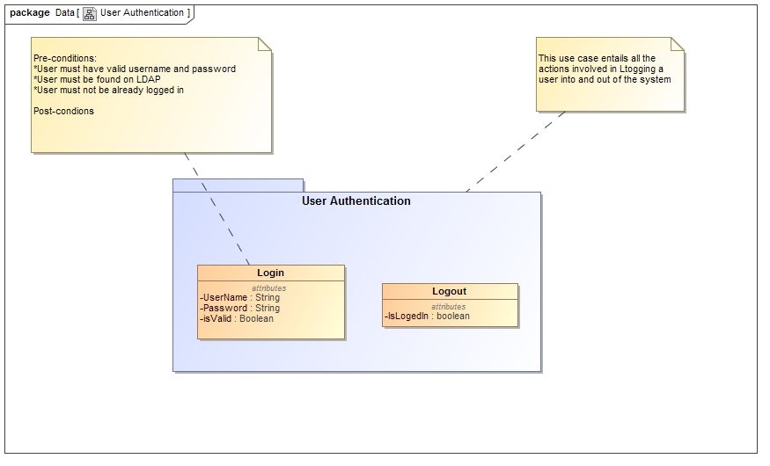
Service Contracts

Slide 21
Architectural Requirements

Slide 22
Completed Sections
1
Templates
2
Cover Page
3
Scalability
4
Usability

Slide 23
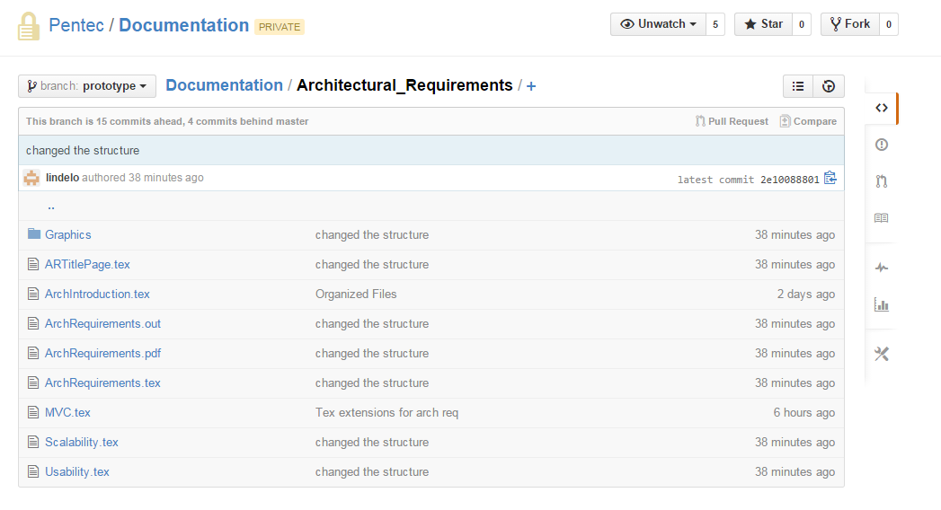
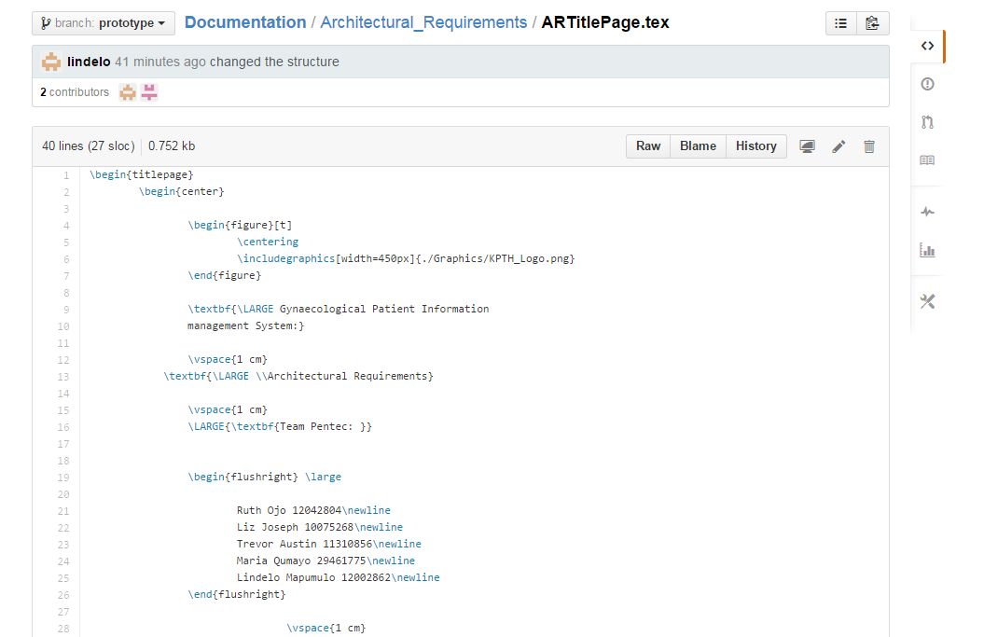

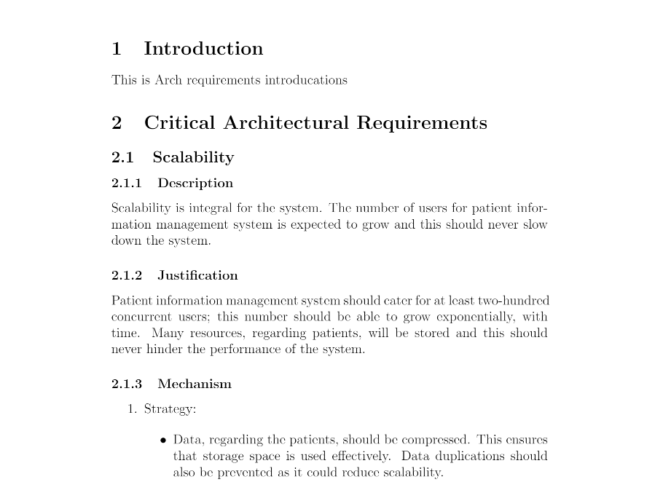
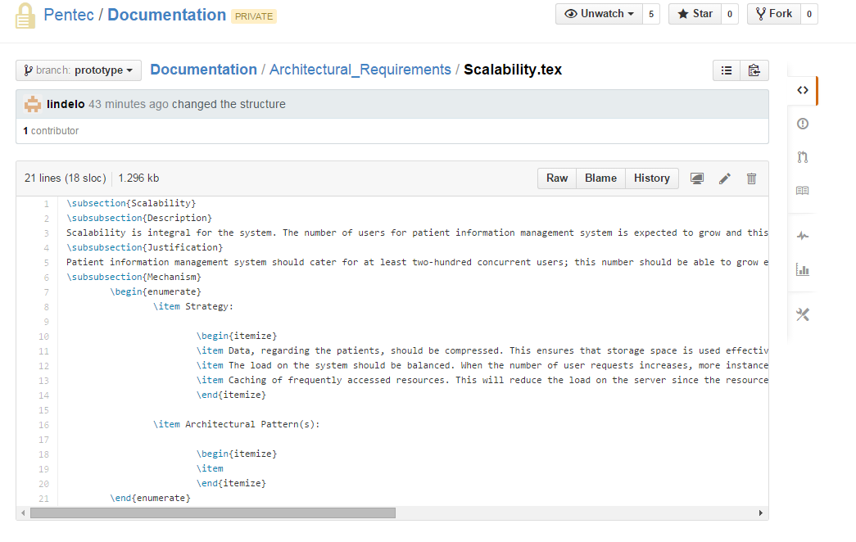
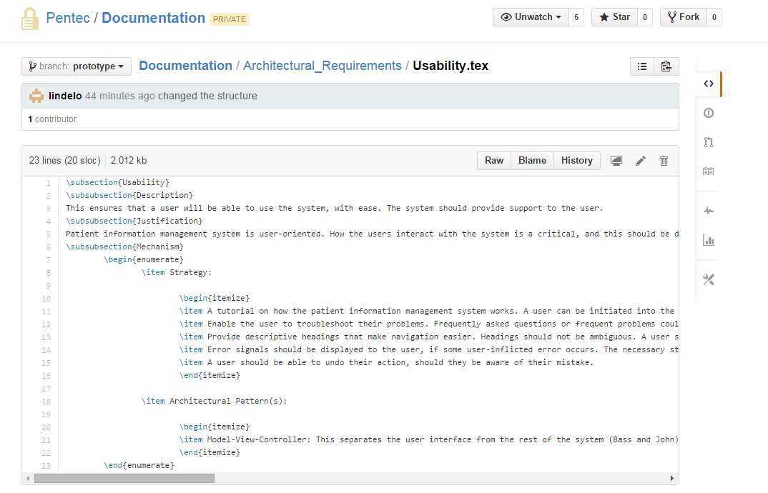
Some Examples of Work

Slide 24
Mock-Up

Slide 25
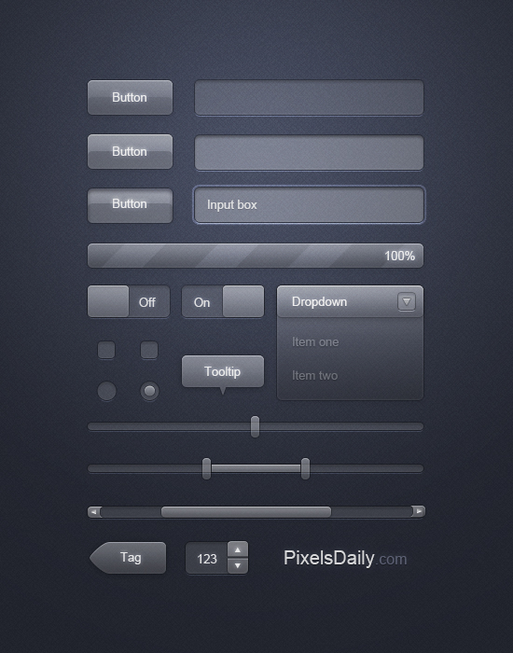

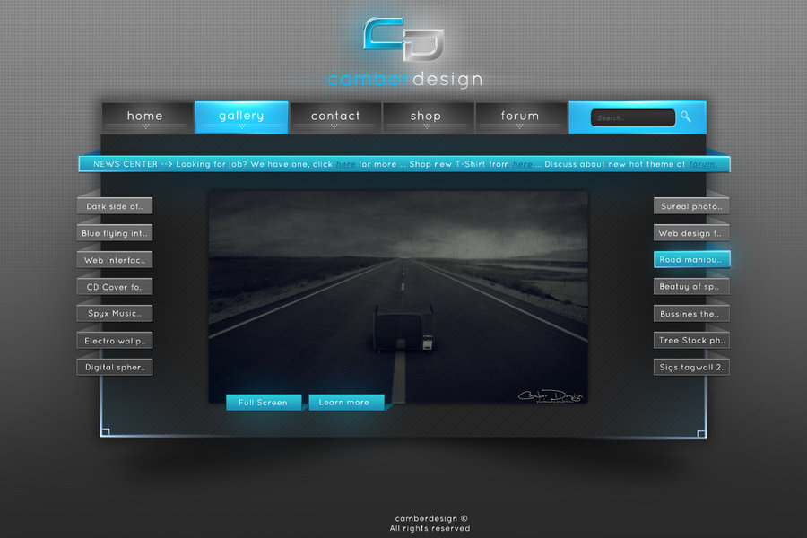
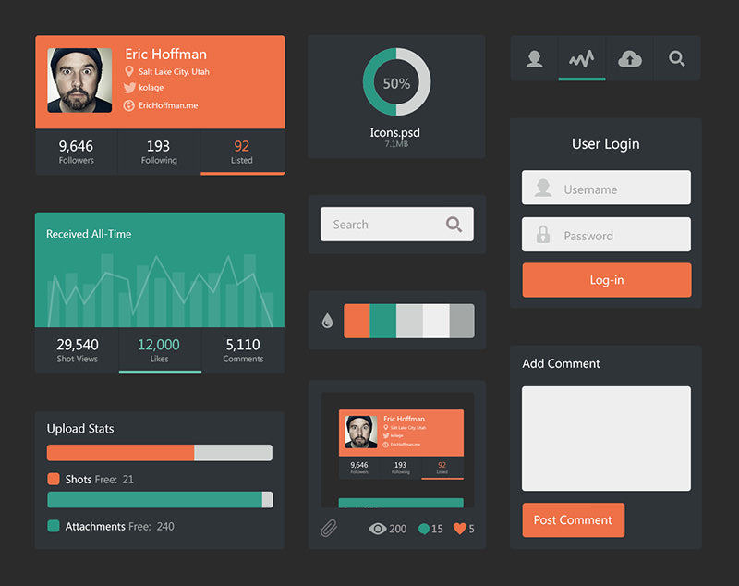
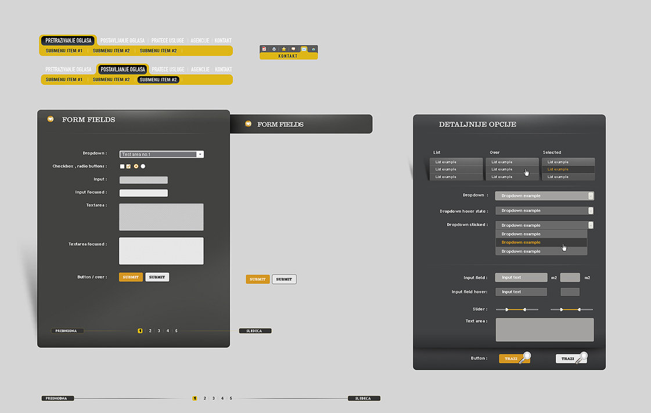
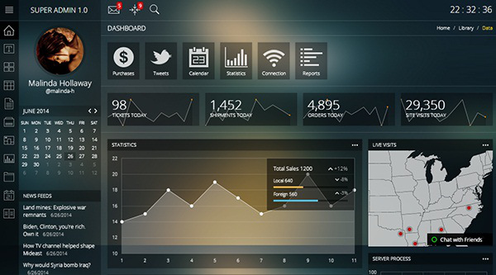
Interface ideas

Slide 26
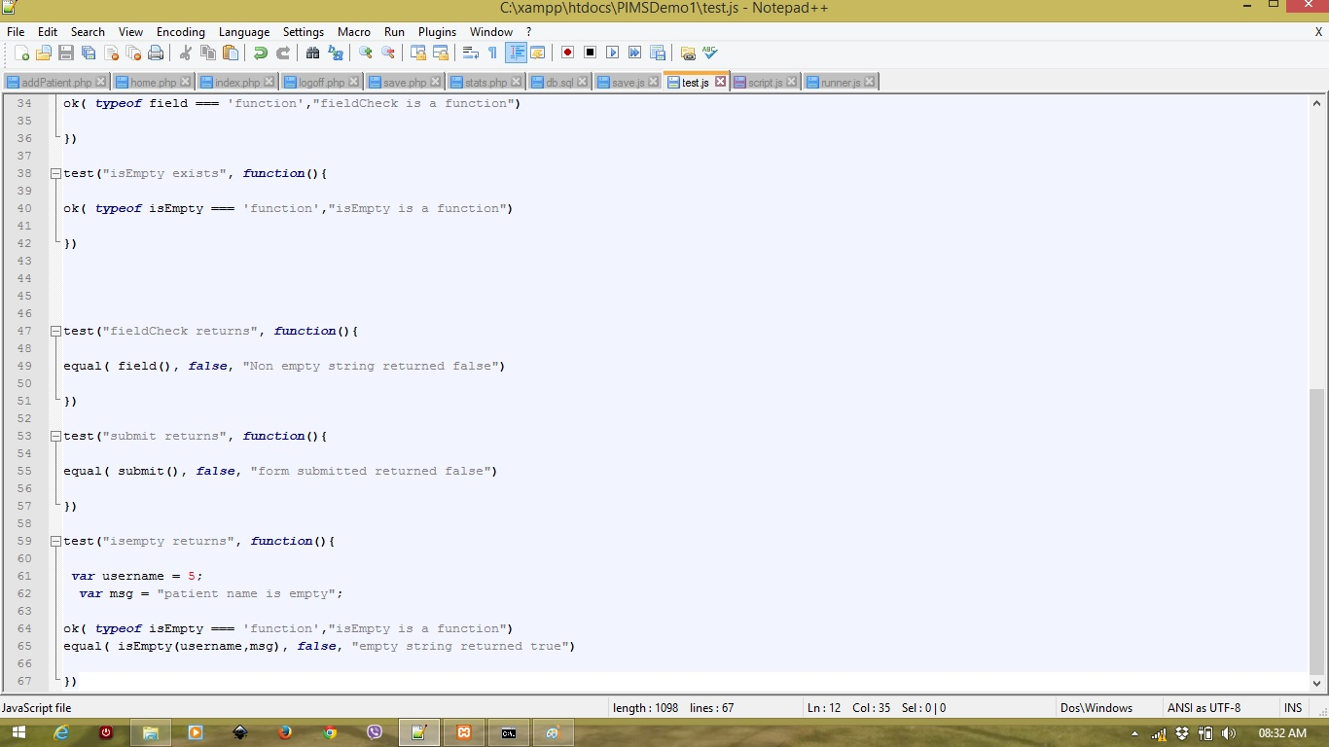
Screenshots
Project 2

Slide 27
Unit Tests
To be demonstrated

Slide 28
Design Documentation
&User Manuals

Slide 29
Information about Docs
1
Templates created for both documents
2
Information will be added as completed

Slide 30

‘Simplicity is the ultimate sophistication.’
-Leonardo da Vinci
Notes:
Questions????

